Slide 1
Insurance Premium Prediction
Raja Vignesh P

Slide 2
Problem Statement
Insurance companies struggle to accurately price policies, leading to potential losses due to underpricing or customer dissatisfaction due to overpricing. The lack of a reliable predictive model hinders the ability to determine fair and competitive premiums, resulting in inefficient risk management and lost business opportunities.

Slide 3
Solution
We will using linear regression for estimating insurance premiums is a valid approach but may have limitations in capturing complex relationships and nonlinear patterns present in insurance data.
It can accurately estimate insurance premiums based on individual risk factors and market trends, enhancing pricing precision and optimizing risk management strategies for insurance companies.

Slide 4
Technologies used
Python: The primary programming language for data preprocessing, modeling, and analysis.
Pandas: For data manipulation and preprocessing tasks, such as handling missing values, encoding categorical variables, and preparing data for modeling.
Machine Learning Algorithm : Used Linear Regression Basic model for estimating insurance premiums.
Scikit-learn: A comprehensive library for machine learning in Python, providing tools for model training, evaluation, and preprocessing (e.g., train-test split, feature scaling, model selection).
Seaborn and Matplotlib: For data visualization, including creating plots and charts to explore data distributions, relationships, and model evaluation.
Jupyter Notebook or IDEs (PyCharm, VS Code): Interactive environments for code development, experimentation, and documentation of results.

Slide 5
Benefits
Improved Pricing Accuracy: By accurately estimating insurance premiums using advanced models, companies can avoid underpricing and overpricing, leading to better profitability.
Enhanced Risk Management: Predictive models help identify high-risk customers and claims, allowing insurers to take proactive measures to mitigate risks and reduce losses.
Cost Efficiency: Automated processes and accurate risk assessment lead to cost savings, ultimately contributing to higher profit margins.
Implementing these strategies with the aid of predictive modeling can contribute to increasing profit percentages in the insurance industry.

Slide 6
Data Collection
Dataset Source: The dataset for the project on Insurance Claim Analysis: Demographic and Health was obtained from Kaggle, a platform known for hosting various datasets and machine learning projects.
The dataset consists of 11 columns in total.
Column Names : index, Patient ID, age, gender, bmi, blood pressure, diabetic, children, smoker, region, claim.
Numerical Columns: age, bmi, blood pressure, children, claim (5 columns)
Categorical Columns: gender, diabetic, smoker, region (4 columns)
Mixed Columns: Patient ID (contains numerical values but likely serves as an identifier rather than a continuous variable)

Slide 7
Data Cleaning
The dataset initially had missing values in the 'age' and 'region' columns, with 5 missing values in 'age' and 3 missing values in 'region'.
These missing values were handled by replacing them with the mean of the 'age' column and the most frequent value (mode) in the 'region' column, respectively.
After handling missing values, the dataset was left with no missing values, ensuring data integrity and preparing it for further analysis and modeling.

Slide 8
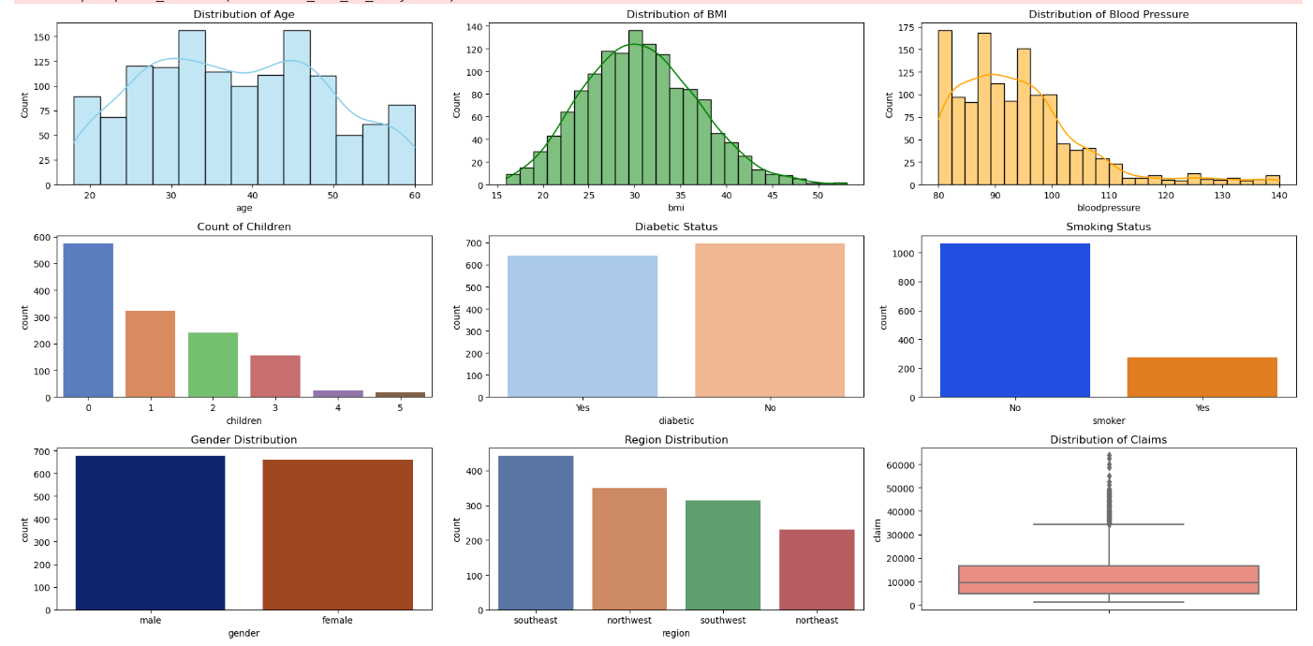
Uni variant analysis

Slide 9
Insights for Uni variant analysis
1.Age Distribution:
The age distribution follows a normal pattern, with peaks in the 32-35 and 43-46 age groups and a lower count in the 50-54 age group. This suggests a diverse age representation in the dataset, potentially impacting insurance premium predictions based on age demographics.
2.BMI Variation:
The BMI distribution is right-skewed, with a high count around the value of 30. This concentration indicates a significant presence of individuals with a BMI of 30, which could influence premium estimations based on BMI-related health factors.
3.Blood Pressure Profile:
The blood pressure distribution does not exhibit a normal pattern, with a majority of individuals having blood pressure in the 80-100 range. Fewer individuals fall in the 110-140 blood pressure range, highlighting potential health considerations that may affect insurance premiums.

Slide 10
Insights for Uni variant analysis
4.Children Count Impact:
Most individuals do not have children, with significant counts for 0 children. The distribution shows decreasing counts as the number of children increases, indicating a potential influence of family size on insurance premium predictions.
5.Diabetic and Smoker Analysis:
There are notable differences between diabetic and non-diabetic individuals, as well as between smokers and non-smokers. These factors can significantly impact health risks and, consequently, insurance premium calculations.
6.Gender and Region Representation:
Gender distribution is balanced, with no significant differences between males and females. In contrast, the region distribution varies, with SouthEast having the highest count, followed by Northwest, Southwest, and NorthEast. These regional differences may reflect varying healthcare costs and lifestyle factors affecting premium predictions.

Slide 11
Insights for Uni variant analysis
7.Claims Amount Distribution:
The claims amount distribution shows that a majority of individuals have claims between 5000-20000, with a small percentage having claims above 35000. This insight can guide risk assessment and pricing strategies for insurance companies based on claim patterns and amounts.

Slide 12
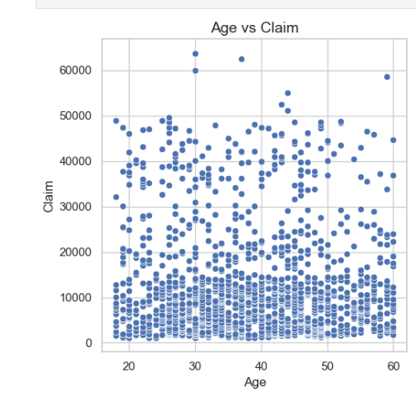
Age vs claim
Age vs. Claim Amount Distribution:
Majority of claim amounts (0-20000) are represented across all age groups, indicating frequent claims in this lower range.
Claims between 20000 and 50000 show relatively fewer data points, suggesting fewer claims in this mid-range category.
Specific Observations for Higher Claim Amounts:
High claim amounts (e.g., 60000) are primarily associated with specific age groups:
Two individuals aged 30.
One individual aged 37.
One individual aged 59.

Slide 13
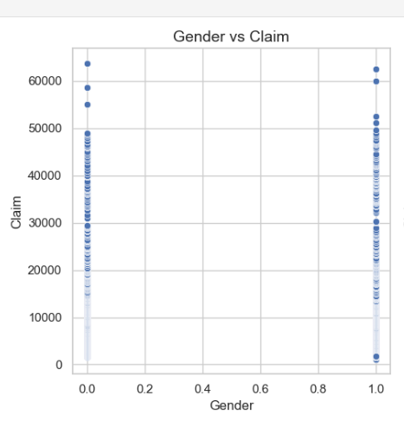
Gender vs claim
Gender vs. Claim Amount Distribution:
The scatter plot shows an equal distribution of data points (scatter dots) for both males and females across different claim amounts.
Claim amounts ranging from 0 to 50000 exhibit a high concentration of both male and female claimants, indicating frequent claims within this range for both genders.
Observations for Higher Claim Amounts:
For claim amounts near 60000:
There are 3 male claimants.
There are 2 female claimants.

Slide 14
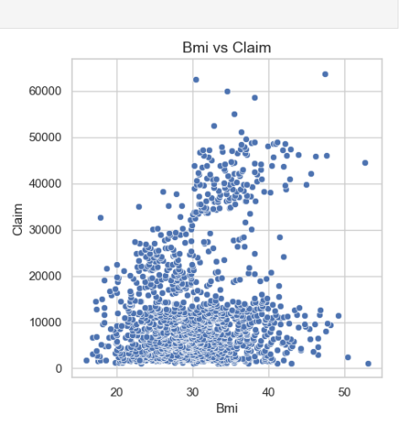
BMI vs claim
Within the BMI range of 20-40, there are notably high dots clustered around claim amounts from 0 to 15000, suggesting frequent claims within this lower claim amount range for individuals with BMI between 20 and 40.
The scatter plot indicates that claimants predominantly have a BMI between 30 and 40, suggesting a correlation between higher claim amounts and BMI in this range.
Near the claim amount of 60000, the BMI values observed are 30, 35, and 38, indicating specific BMI values associated with higher claim amounts in this range.

Slide 15
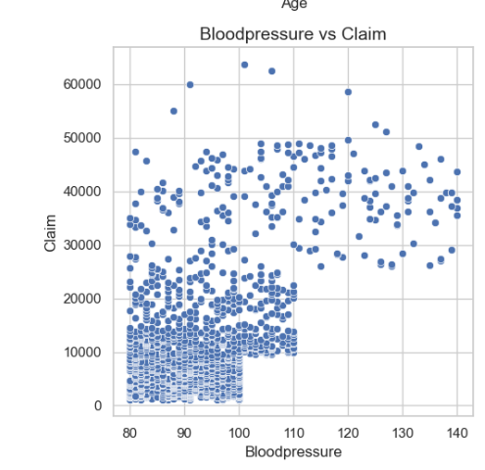
Blood pressure vs claim
Blood pressure values between 80 and 100 are associated with a higher concentration of claims in the range of 0 to 10000, indicating frequent claims among individuals with this BP range and lower claim amounts.
For claim amounts between 10000 and 20000, blood pressure values range from 80 to 110, suggesting a broader range of BP values associated with mid-range claim amo
Blood pressure values above 110 are linked with claim amounts ranging from 30000 to 50000, indicating higher claim amounts for individuals with elevated BP levels.unts.

Slide 16
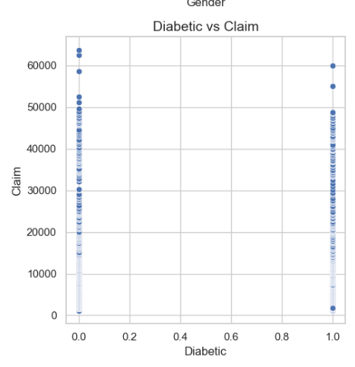
Diabetic vs claim
In the dataset, there are approximately 600 diabetic individuals and around 700 non-diabetic individuals.
Most of the diabetic and non-diabetic individuals have claim amounts ranging from 0 to 50000.
Diabetic individuals tend to have higher claim amounts, including claims above 60000.
Non-diabetic individuals generally have claim amounts up to a maximum of 60000.

Slide 17
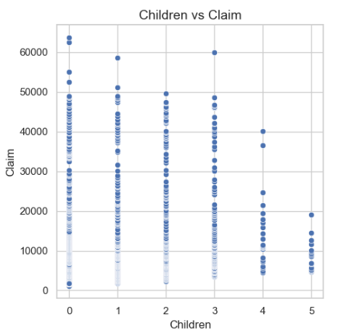
Children vs claim
Individuals with 0 children tend to have higher claim amounts, with claims ranging from 0 to 65000.
Individuals with 1 child have claim amounts up to 58000.
Individuals with 2 children have claim amounts up to 50000.
Individuals with 3 children have claim amounts up to 49000, with one exception having a claim amount of 60000.
Individuals with 4 children have claim amounts up to 40000.
Individuals with 5 children have claim amounts up to 20000, indicating lower claim amounts for larger families.

Slide 18
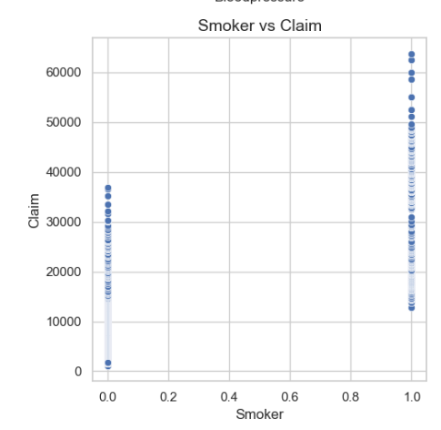
Smoker vs claim
Smokers tend to have higher claim amounts, ranging from 10000 to 65000.
Non-smokers have lower claim amounts, generally up to 38000, with the majority of claims below 35000.
Smokers have higher claim amounts compared to non-smokers, with a wider range of claim values observed among smokers.

Slide 19
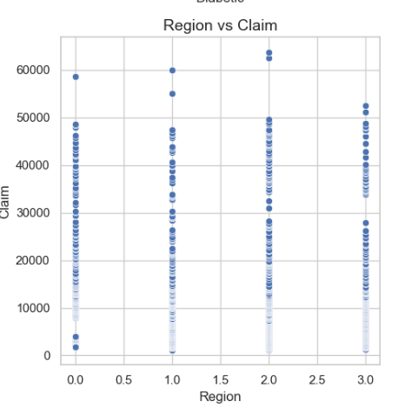
Region vs claim
All four regions (Southeast, Northwest, Southwest, Northeast) show a similar distribution of data points (high dots) across various claim amounts.
The majority of claim amounts across regions are clustered around 50000, indicating a common claim amount trend across different regions.
Specific observations for higher claim amounts in each region:
Southeast: One individual claimed 58000.
Northwest: Two individuals claimed above 55000.
Southwest: Two individuals claimed above 60000.
Northeast: Two individuals claimed above 50000.

Slide 20
Data Preprocessing
The LabelEncoder was applied to each categorical column in the DataFrame to transform object-type data into numerical representations.
The unnecessary 'Index' and 'PatientID' columns were dropped from the dataset as they do not contribute to the model training process.
Feature selection was performed to identify and retain the most relevant features that significantly influence insurance premiums, enhancing the model's predictive accuracy.

Slide 21
Model Training
Linear Regression for Continuous Target Variable
Since the target column 'claim' is a continuous variable, linear regression is an appropriate choice for modeling the relationship between the predictor variables and the insurance premiums
Splitting Data into Training and Testing Sets
The preprocessed dataset should be split into training and testing sets to evaluate the model's performance and prevent overfitting.
A common practice is to use 80% of the data for training and 20% for testing.

Slide 22
Model Training
Implementing Linear Regression Model
Use an appropriate library or framework, such as scikit-learn in Python, to implement the linear regression model.
Train the model on the training set, allowing it to learn the relationships between the predictor variables and the target variable.
Evaluating Model Performance
Assess the model's performance using appropriate metrics such as R-squared, adjusted R-squared
These metrics will help determine the model's accuracy in predicting insurance premiums.

Slide 23
Validation & comparision
Comparison of Regression Models:
Linear Regression:
R2 Score: 0.7271, Adjusted R2 Score: 0.7216
Polynomial Regression:
R2 Score: 0.7071, Adjusted R2 Score: 0.6701
Lasso Regression:
R2 Score: 0.7271, Adjusted R2 Score: 0.7215
Ridge Regression:
R2 Score: 0.7263, Adjusted R2 Score: 0.7207
Elastic Net Regression:
R2 Score: 0.4285, Adjusted R2 Score: 0.4169

Slide 24
Validation & comparision
Conclusion:
Lasso Regression and Linear Regression perform similarly with the highest R2 scores and adjusted R2 scores.
Ridge Regression closely follows with slightly lower scores.
Polynomial Regression shows good performance but slightly lower than linear-based models.
Elastic Net Regression lags behind with the lowest scores.
So we choose Linear Regression algorithm for this insurance premiums prediction

Slide 25
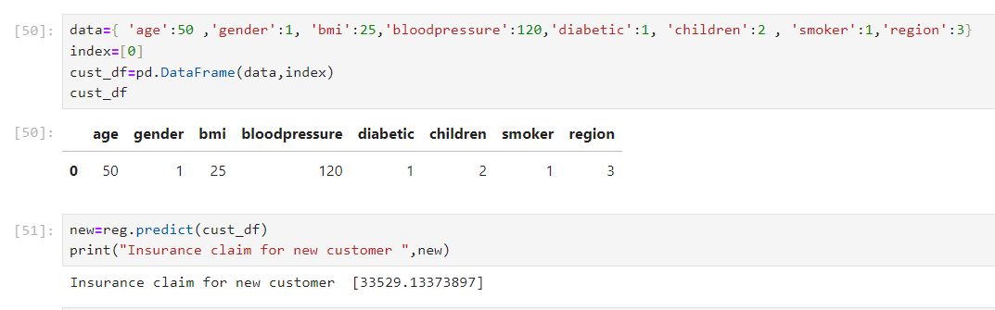
Prediction

Slide 26
Prescriptive analysis
Focus on marketing campaigns tailored to the South East region, highlighting insurance products and benefits that resonate with local demographics and needs.
Offer specialized policies or incentives for individuals with diabetes, high blood pressure, and smokers, addressing their specific health concerns and risk factors.
Create targeted promotions for individuals with 0 children and BMI values between 20-40, emphasizing tailored coverage options and competitive premiums.

Slide 27
Prescriptive analysis
Implement proactive wellness programs and health initiatives to promote preventive care and healthier lifestyles among policyholders.
Enhance transparency in policy terms and pricing, ensuring customers understand the value they receive and the factors influencing their premiums.
Offer personalized risk assessment and coverage recommendations based on individual profiles, empowering customers to make informed decisions.
Provide efficient claims processing and responsive customer support, ensuring a seamless experience during policy management and claims.
Continuously analyze customer feedback and data insights to refine product offerings, pricing strategies, and service delivery, aligning with evolving customer expectations and needs.

Slide 28
Thank You

